Slide 1

Udemy Data Analysis
By Elvis Kwabena Asare Nkrumah

Slide 2

Project Description:
To better understand the pricing and subscriptions data of Udemy courses (for four different subjects) and identifying trends and patterns
This will help us to:
Identify for which subject more courses should be created
Create targeted strategies to increase the company revenue

Slide 3
Key questions:
What are the total numbers of subscribers in each subject?
How does the average content duration/price/number of students vary across different subjects?
How many courses are free and paid for each subject?
What is the average price of web development courses at different levels?
What are the 20 most popular courses? Also, include the following information:
Their level
Whether they are free or paid
Whether any are free beginner courses,
and the duration of the courses.
Does content duration impact the price of the course?

Slide 4

Findings & Insights

Slide 5

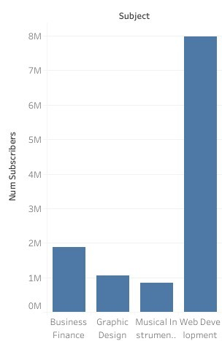
1. What are the total numbers of subscribers in each subject?

Slide 6
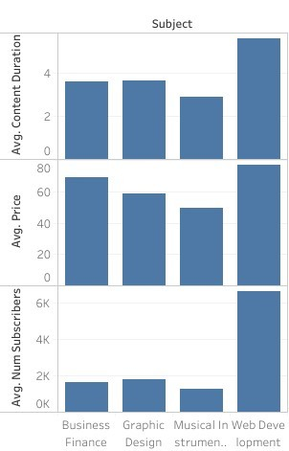
2. How does the average content duration/price/number of students vary across different subjects?
Key Findings
Web Development courses had the longest content duration times followed by graphic design, business finance and musical instrument courses.
The cost of web development courses was the
highest followed by business finance, graphic design and musical instrument courses.
On average, web development courses had the
highest number of subscribers followed by graphic design, business finance and musical instrument courses.
Hence, web development with higher prices appear
to have more subscribers and longer content durations.

Slide 7
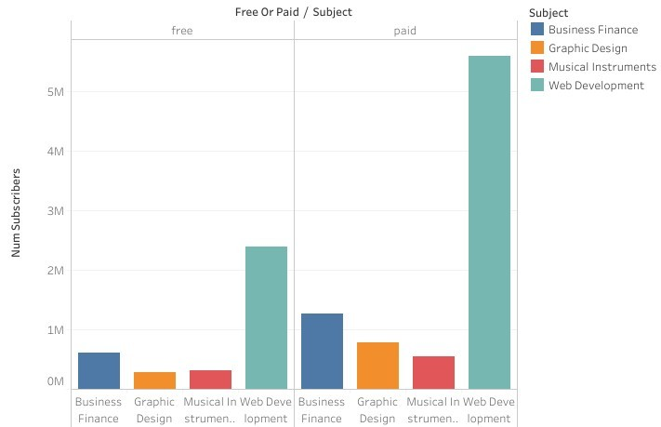
3. How many courses are free and paid for each subject?
Key Findings
Free and paid Web development courses had the most number of subscribers.
Comparatively, paid web
development courses had more subscribers as compared to the free ones.
This can imply that the more costly a web development course is the more subscribers it is likely to obtain
The other subjects had less subscribers in both cases

Slide 8
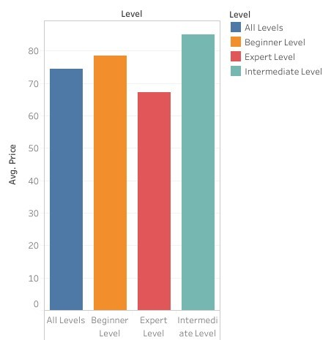
4. What is the average price of web development courses at different levels?
Key Findings
This information suggests a trend in pricing based on the course difficulty level.
By comparison, intermediate-level web development courses had the highest price on average followed by beginner, all-level and expert-level courses
The pricing differences may reflect a
strategic approach by course providers to cater to different segments of the market. For example, higher prices for intermediate courses might be justified by the perceived value of more in-depth content.

Slide 9
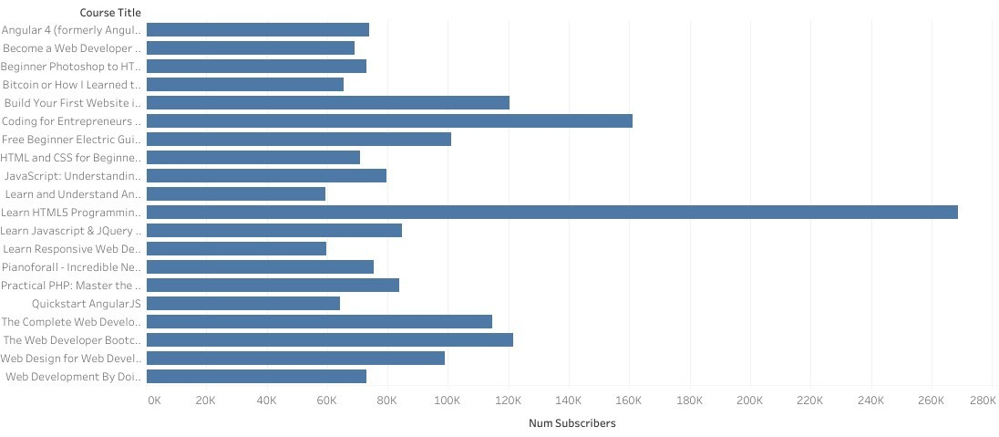
5. What are the 20 most popular courses?
Key Findings
The chart shows the list of the 20 most popular courses.
From observation,15 of these courses are web development courses with the most popular course being one

Slide 10
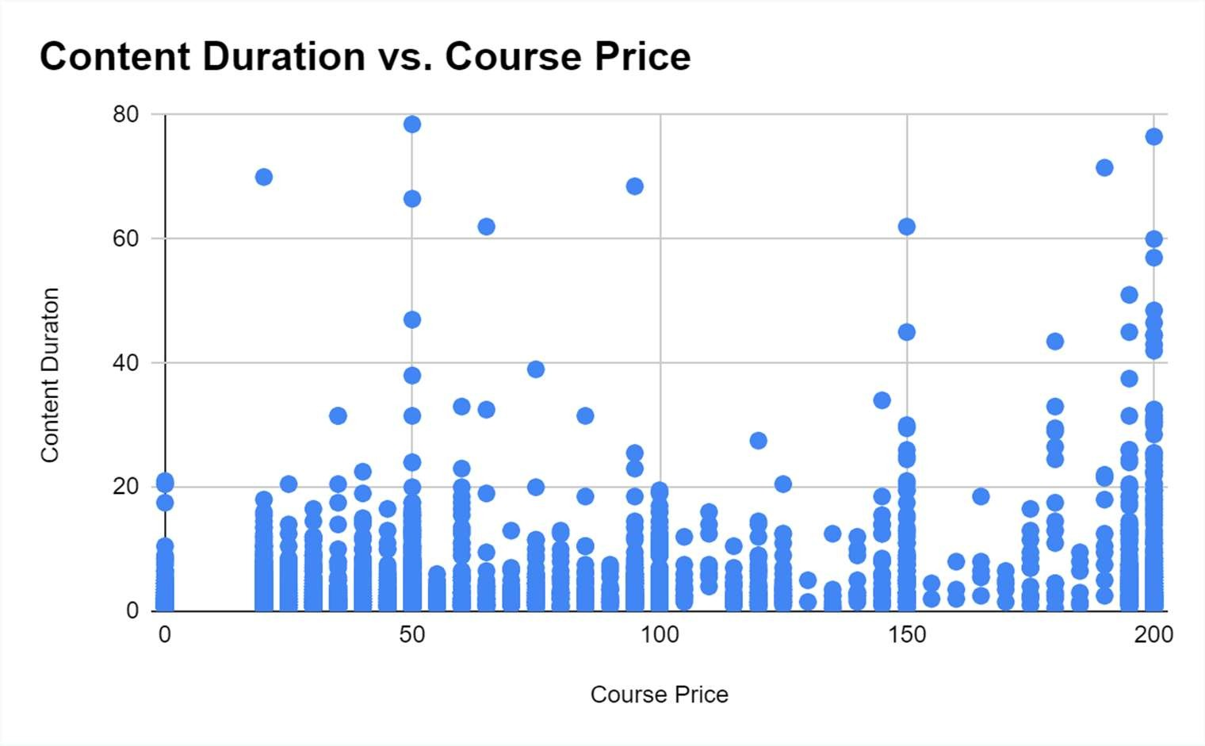
6. Does content duration impact the price of the course?
Key Findings
From the chart, courses with less content duration were cheaper than courses with higher content duration
Longer courses may be priced higher to reflect the extended content and potentially greater value offered to learners.
Learners evaluating these courses may take content duration into account when making decisions, expecting longer courses to justify higher prices.

Slide 11
Summary

Slide 12
Summary of findings:
Top 5 courses:
Almost 68% of subscribers come from Web Development and the top 5 courses are for Web development as well
Business Finance vs Web Development:
Business Finance and web development have almost equal number of total courses (1155 vs 1203), but web development course are almost 2x in content duration and have 4x the average subscribers
Course Pricing:
Web development courses on average had the highest prices followed by Business Finance, graphic design and Musical instrument courses. Course prices ranged from 0 to 200 with most being web development courses

Slide 13
Actions & Recommendations

Slide 14
Recommended actions:
Product recommendations:
Expand your course catalog to cover a wider range of paid web development courses covering different subjects. By offering more paid intermediate web development courses, you can attract a broader audience of paying customers.
Marketing recommendations:
Emphasize the high quality, up-to-date content, and real-world applicability of our web development courses. Showcase success stories and testimonials from satisfied learners who have benefited from our offerings.
Create a sense of urgency by introducing limited-time offers, discounts, or early bird pricing for our web development courses. Encourage potential customers to take action quickly to secure their spots.

Slide 15






